Slide 1
The tab layout and menu entries in the Metadata Editor
Yoel Kortick
Senior Librarian

Slide 2

Agenda
Navigation pane tabs for record types
Dynamic menu entries in the editor pane
Dynamic menu entries in split editor mode

Slide 3
Navigation pane tabs for record types

Slide 4
Navigation pane tabs for record types
The tabs which indicate record types and how many records are open in the Metadata Editor for a specific type are on the top of the navigation pane.
When there are more tabs than can fit in the top of the navigation pane an indication exists that there are more options, and clicking this indicator provides access to the additional tabs.
This saves valuable space in the Metadata Editor.
Let’s take a look at this.

Slide 5
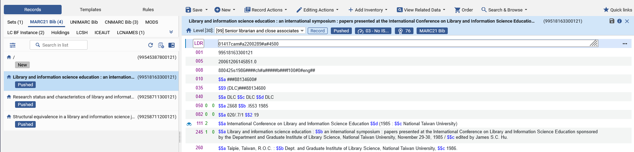
Navigation pane tabs for record types
The tabs and divisions of record type indications are as follows

Slide 6
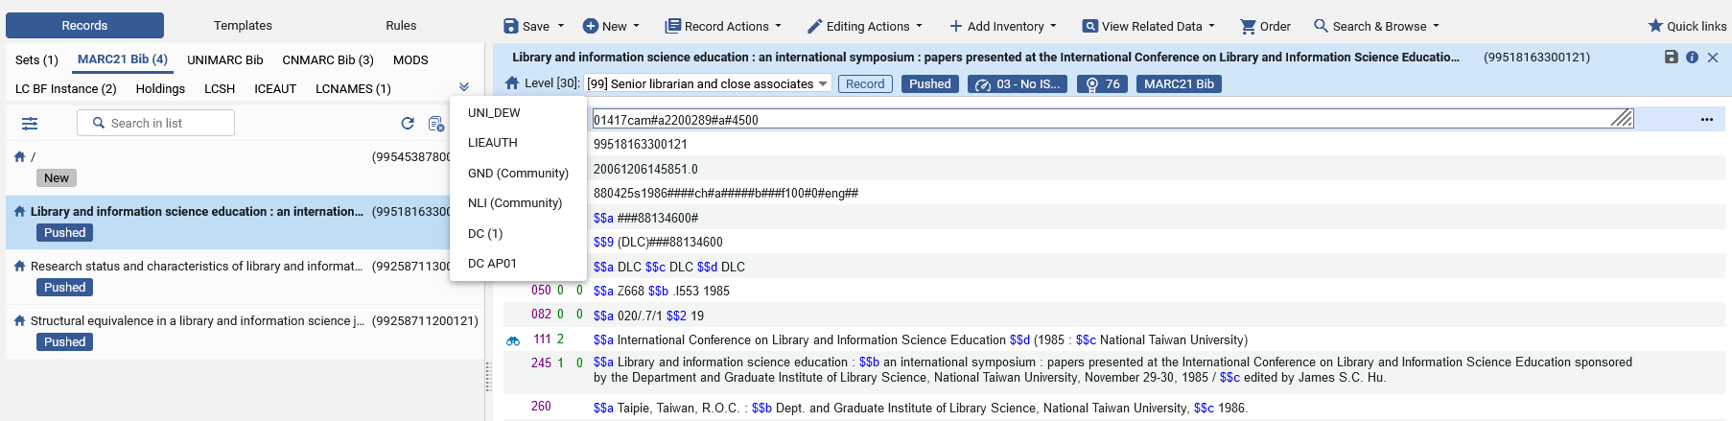
Navigation pane tabs for record types
And additional tabs (when existing) can be accessed as follows:
Now for example we will click “DC (1)”

Slide 7
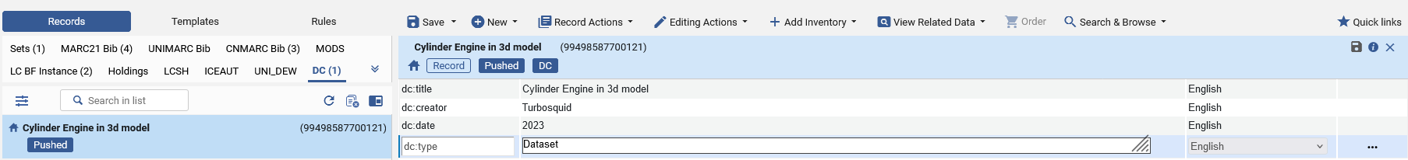
Navigation pane tabs for record types
And now we have access to the 1 DC record which was open in the Metadata Editor.

Slide 8
Dynamic menu entries in the editor pane

Slide 9
Dynamic menu entries in the editor pane
The menu entries which appear in the editor pane are dynamic. They differ depending on the entity type being handled.
The menu entries which appear, for example, for a bibliographic record differ from those which appear for a cataloging template.

Slide 10
Dynamic menu entries in the editor pane
In the example we will see here the menu entries which appear for a template completely differ than those which appear for a bibliographic record, authority record and holdings record.

Slide 11
Dynamic menu entries in the editor pane
The active menu entries differ for a bibliographic record, authority record and holdings record.
“Add Inventory” is not relevant for an authority record and therefore this option is active only for bibliographic records and holdings records.
“Order” is relevant only for bibliographic records and therefore it is active in the menu for a bibliographic record, but it is not active in the menu for an authority record or a holdings record.

Slide 12
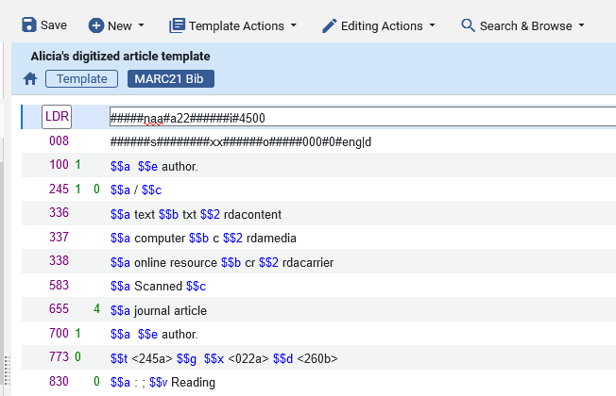
Dynamic menu entries in the editor pane
These are the menu entries which appear when editing a cataloging template

Slide 13
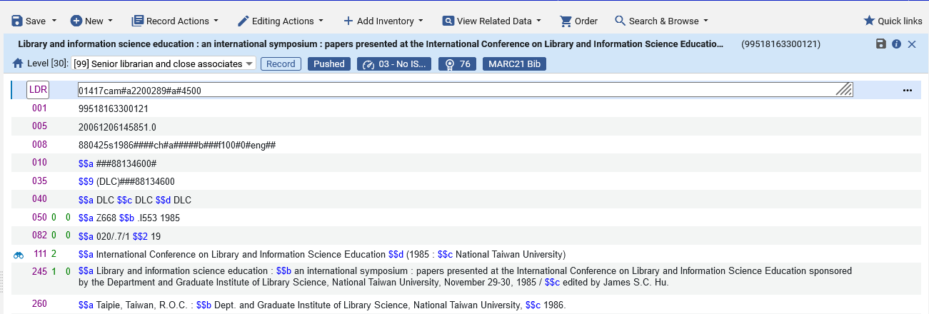
Dynamic menu entries in the editor pane
These are the menu entries which appear when editing a bibliographic record
“Order” is relevant only for bibliographic records and therefore it is active in the menu for a bibliographic record, but it is not active in the menu for an authority record or a holdings record.

Slide 14
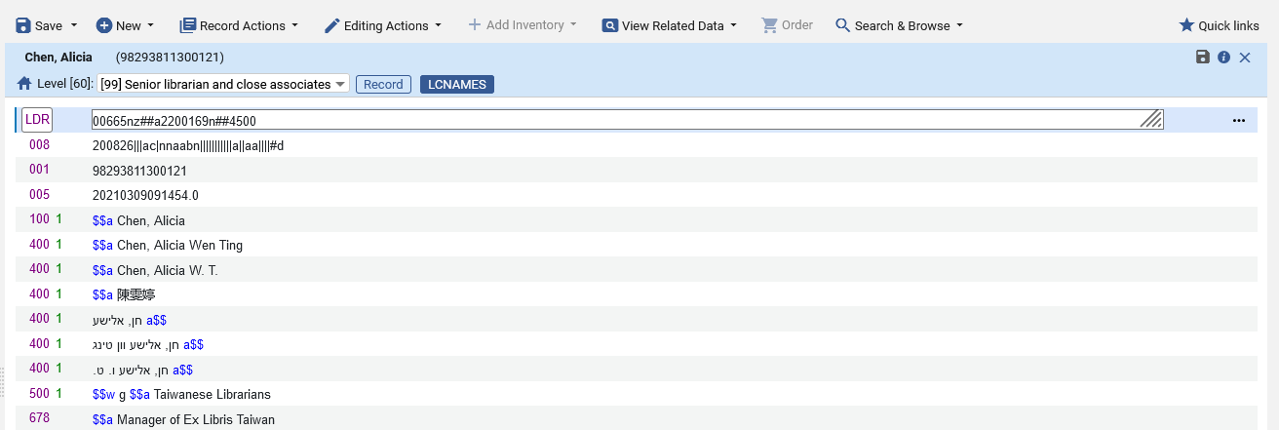
Dynamic menu entries in the editor pane
These are the menu entries for an authority record
“Add Inventory” and “Order” are not relevant for an authority record and therefore these options are not active here.

Slide 15
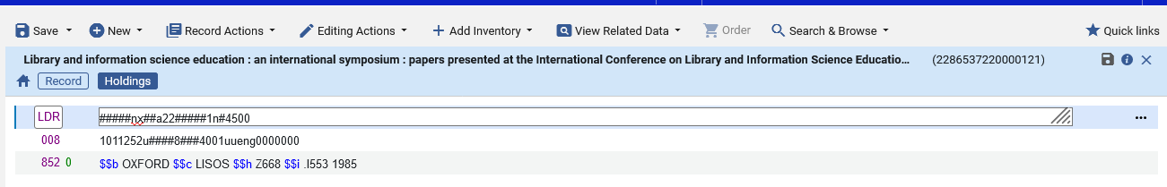
Dynamic menu entries in the editor pane
These are the menu entries for a holdings record
“Order” is not relevant for a holdings record and therefore this option is not active here.

Slide 16
Dynamic menu entries in split editor mode

Slide 17
Dynamic menu entries in split editor mode
The menu entries are sensitive to the record types also when records are viewed in split editor mode.
For example, a bibliographic record and an authority record may be viewed side by side simultaneously in the Metadata Editor.
If the focus is on the bibliographic record, then the menu entries “Add Inventory” and “Order” will appear.
If the focus is on the authority record, then the menu entries “Add Inventory” and “Order” will not appear

Slide 18
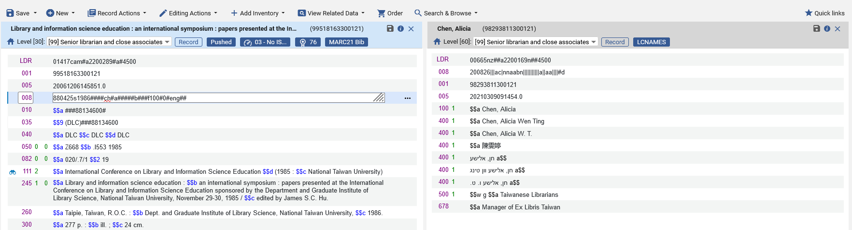
Dynamic menu entries in split editor mode
Focus is on the bibliographic record on the left and therefore the menu options “Add inventory” and “Order” are active.

Slide 19
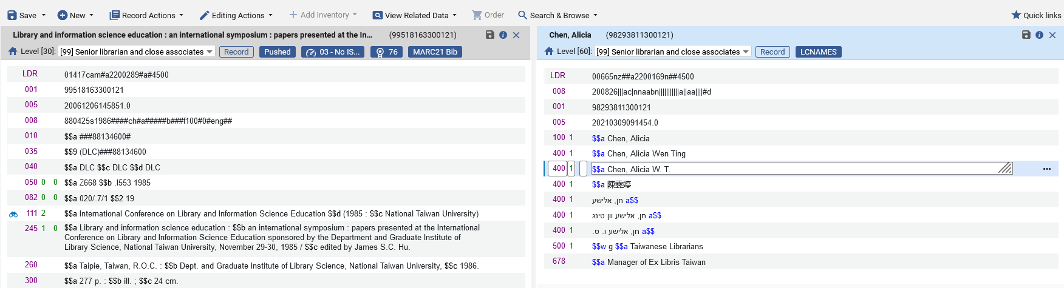
Dynamic menu entries in split editor mode
Focus is on the authority record on the right and therefore the menu options “Add inventory” and “Order” are not active.

